Slide 1

The Continuum Transfunctioner® User Manual
The Cal Poly Task Force

Slide 2

The Continuum Transfunctioner
The Continuum Transfunctioner is an all inclusive military grade uber belt
Created for C.I.A. personnel only
Some Notable Functions:
Invisibility
Teleportation
Time Travel

Slide 3
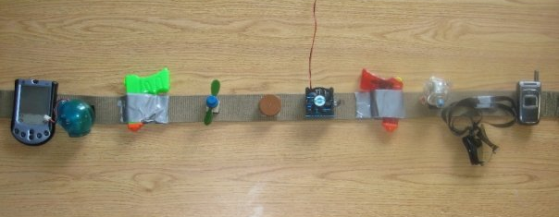
Our Product

Slide 4
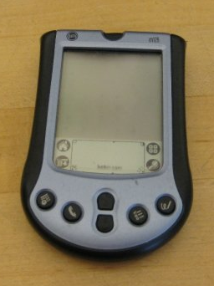
The Control Unit
Your Personal Digital Assistant (PDA) provides the metaphorical brain of the system
Contains multiple input methods: voice activation, onscreen keyboard, and support for “graffiti” style writing
A fully functional standard PDA in addition to its purpose as a control unit for the belt’s three primary features
Invisibility-Provides the real time processing, allowing for a persistent cloaking device despite any movement
Teleportation-Incorporated GPS & Inertial Reckoning allows for millimeter precise transports
Time Travel-A revolutionary Ytterbium⁺² optical lattice allows for the precision time keeping required to shift time frames

Slide 5

Invisibility
The Continuum Transfunctioner® absorbs light from every angle of the human body
Emits the light absorbed at a 180 degree angle.
You do not truly see through the “invisible” person, but you see the image of
what is on the opposite side of
that person produced in a
flawless manner making him
appear invisible.

Slide 6
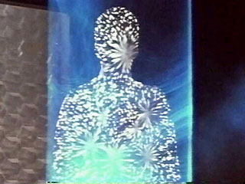
Teleportation
By bending three-dimensional reality through the fourth dimension, which is time, a person can travel from one point in space to any other point in space by moving merely inches from their original position.
Does not decompose matter and recompose it in a different place.

Slide 7
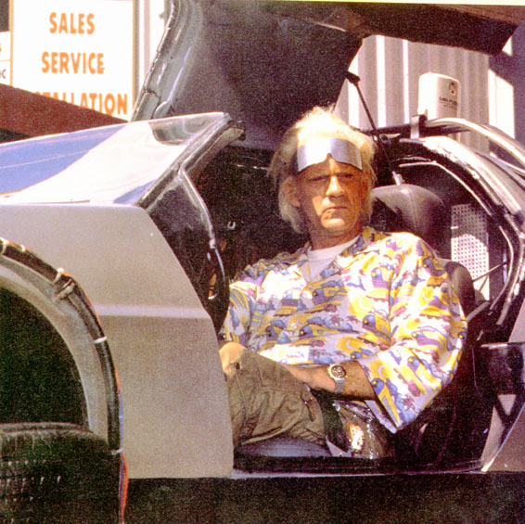
Time Travel
Bends time through the fifth dimension, much in the same way that the teleportation device bends space through the fourth.
Allows a person to step from one point in time to another while using the time-travel feature.

Slide 8

Accessories
Along with the three main functions of the belt, we have included many accessories which the CIA may find useful for their various field operations.

Slide 9

Accessories
Underwater Digital Camera
Propeller
Parachute
Zero-G Fan®
Hydroxy Separation Respirator
Multipurpose Goggles
Non-traceable Cell Phone
Dual Laser Pistols

Slide 10

Why Would You Want This
Intelligence Gathering
Safety for Field Agents
Fix Past Mistakes
Edge over opponents

